Slide 2
Case study solution By Juan Camilo López

Slide 3
Content
1. Part A: Analysis based on accounts specialty
Part B: Analysis of our patient satisfaction based on NPS methodology (Net Promoter Score)

Slide 4
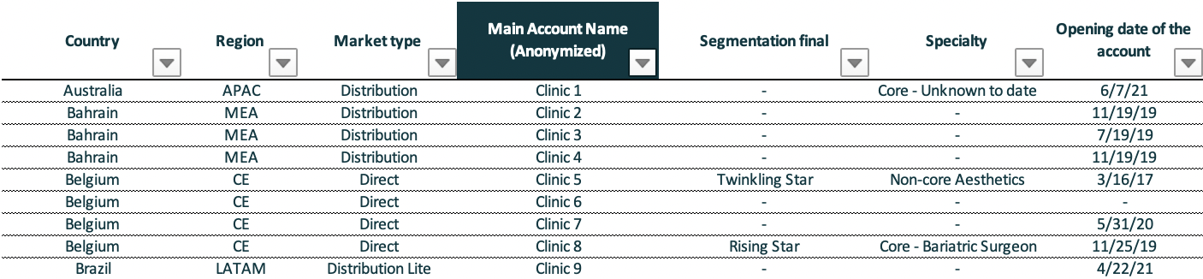

Part A
In this part, we are going to analyze quarterly sales and their dependency on the type of account (Specialty feature)
Our dataset consists of 574 entries with 28 features each; the 7 shown below and 21 extra that correspond to quarterly sales from 2017
The data was cleaned and manipulated using Pandas, which is the most famous data frame manipulation library in Python
Every result and graph was created using the DataViz library Seaborn

Slide 5
results
Recall:
Core account: Accounts with a bariatric surgeon or a gastroenterologist/Endoscopist
Non-Core account: Accounts with an Aesthetic physician, a physician nutritionist, or others
Multispecialty: Accounts with physicians from both types

Slide 6
Recall:
Core account: Accounts with a bariatric surgeon or a gastroenterologist/Endoscopist
Non-Core account: Accounts with an Aesthetic physician, a physician nutritionist, or others
Multispecialty: Accounts with physicians from both types

Slide 7
Insights
For the past 3 years, the number of new core accounts created per quarter is highly correlated with the sales from core accounts
This means that we can safely assume a linear relationship between the increase in popularity of core accounts and sales
if we can associate another variable with the popularity of core accounts (e.g marketing expenses) we can predict future sales

Slide 8
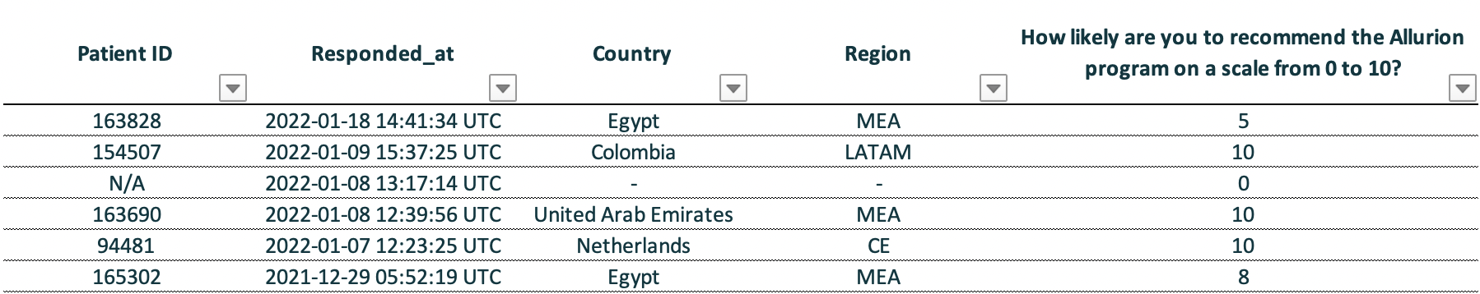
Part B
For this part, we are going to monitor the patient satisfaction database, which recollected via the user satisfaction app
This database consists of 5 different features with 15419 entries.
To analyze the database we are going to use the NPS metric, which is calculated using in the following way:
$$NPS=100 ∗\frac{\left(promoters −detractors\right)}{total}$$
Where promoters are the number of people that rated 9 or 10, and detractors are the number of people that rated 6 or less

Slide 9
Overall NPS
Results
The overall historical NPS was found to be 25
The monthly values for the NPS were plotted. The values have been historically confined between 35 and 20, which is fairly stable since the scale ranges from -100 to 100

Slide 10
Historical NPS of key markets

